Slide 1
CSCI 2200: Intro to Unix
Filters and Pipes

Slide 2
Focus
Objectives
Manipulating data outside of databases– typically, text
Automating processes
Doing so efficiently and concisely, by
  Using pre-existing utilities, a.k.a. tools/ filters,
  without having to create these from scratch
  Working with flows of data, rather than loops

Slide 3
Importance
Manipulating text outside of databases is a key accountability for data science
Programming with flows rather than loops
  makes for more concise—hence, clearer and cleaner—logic
  is a key accountability for functional programming and the parallelism it provides
Automating (i.e., scripting) processes
  documents those processes
  makes them more efficient

Slide 4
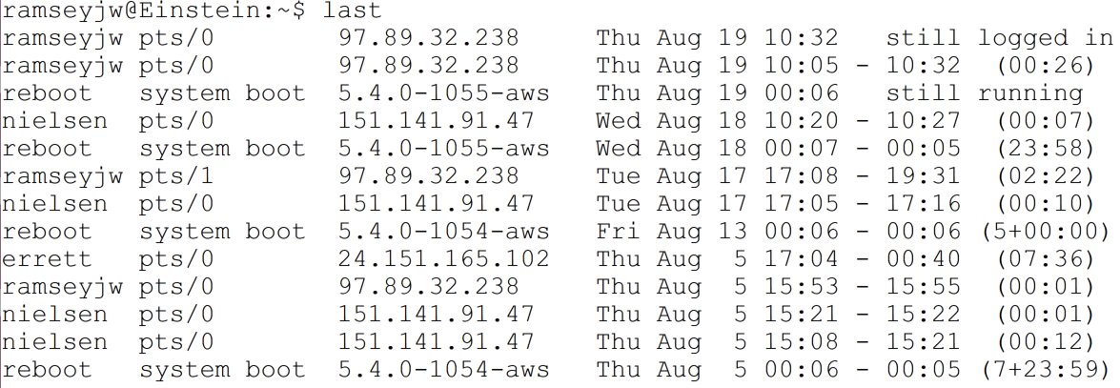
Representative Problem: Summarizing Content from last
last shows user logins, in reverse chronological order
For each login, last shows
  -- account -- time of login
  -- local terminal in use -- time of logout
  -- origin of login -- total time of login

Slide 5
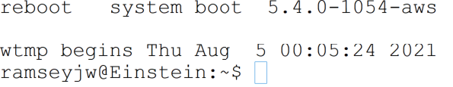
Example: output from last (trailer)
last also generates a two-line trailer
Trailer specifies
  file from which this data was taken (default: wtmp)
  when this file started recording logins
So, a bit of brainstorming:
  what kinds of information can be gleaned from last?
  what steps are needed to get it?

Slide 6
Accounts that Were Accessed
Drop last's trailer
Isolate the first column
Eliminate duplicates

Slide 7
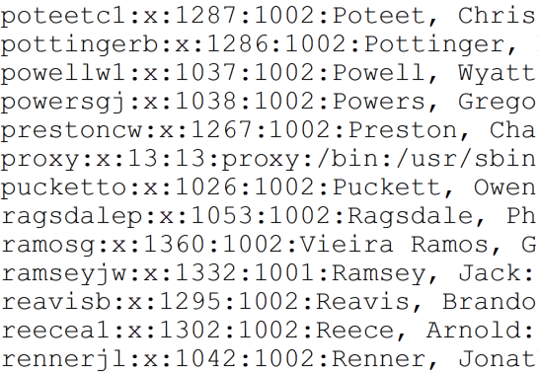
Accounts that Weren't Accessed
Get accounts that were accessed, as per last slide
Get list of all accounts from first column of /etc/password

Slide 8
Accounts that Weren't Accessed
Determine what accounts are in the 2nd list that aren't in the 1st: e.g.,
  Blend the two lists
  Identify all accounts that appear exactly once

Slide 9
Logins per User
Get accounts that were accessed, as per earlier slide
Count occurrences of each account: e.g., by
  Sorting the list
  Counting occurrences of adjacent names

Slide 10
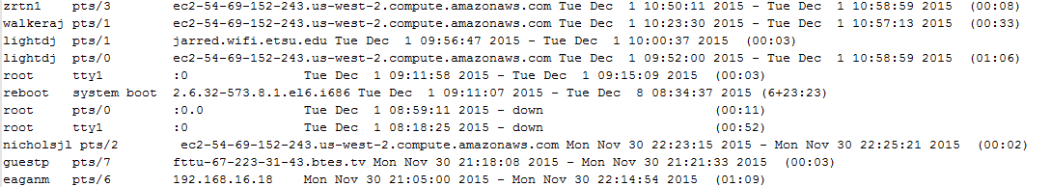
Data on Root Logins
Motivation: concerns about system security
  actions by root represent potential threats to system security
  remote logins that aren't accounted for are of particular concern
Strategy
  drop last's trailer
  extract all lines that start with root

Slide 11
Data on Reboots
Motivation
  reboots represent downtime
  reboots that aren't accounted for could indicate threats to security
Strategy
  drop last's trailer
  extract all lines that start with reboot

Slide 12
Accounts with Login Hosts
Motivation
  logins from overseas could indicate a security breach
Strategy
  drop last's trailer
  retrieve first and third fields from remaining records
  do further analysis to check for suspicious hosts: e.g.,
  match host name suffixes with list of problem domains

Slide 13
Accounts with Login Durations
. . .
Motivation: determining (e.g.)
  total login time, per user/ for all users
  longest login, per user/ for all users
  average login, per user/ for all users
Strategy
  drop last two lines from last's output
  get first, final fields from other records

Slide 14
Programming Tools – a.k.a. Filters
Tools often referred to (somewhat misleadingly) as filters
Unless otherwise stated, filters support redirection of stdin, stdout, and stderr
  Commands that accept input from stdin can operate on streams as well as files, as explained in material on files

Slide 15
Programming Tools – a.k.a. Filters
Filters divided here into five (rough) groups
  Extractors – extract content from source streams: e.g.,
    based on counts of rows, columns
    based on content that rows contain, including pattern matching
  Summarizers – calculate summary statistics for streams
  Combiners – bring streams together
  Mutators – rewrite content in source streams
    As a rule, based on pattern matching
  Flow control – manage flow of content to user, other utilities

Slide 16
Extractors
Goal: extract desired content from a source stream, discarding irrelevant content
Two broad categories of extractors
  Four that take horizontal slices (i.e., rows) from a source stream, selecting
    the front of a stream (head)
    the back of a stream (tail)
    rows that match a pattern (grep)
    repeating/ nonrepeating adjacent rows (uniq)
  One that takes vertical slices (i.e., columns) from a source stream (cut)

Slide 17
head – output stream's initial lines
head file
outputs first 10 lines of file
head -n N file
outputs file's first N lines – or entire file, if file has fewer than N lines
head -n -N file
outputs all but file's last N lines – or nothing, if file has fewer than N lines

Slide 18
tail – output stream's final lines
tail file
outputs last 10 lines of file
tail -n N file or tail -N file
outputs file's last N lines – or nothing, if file has fewer than N lines
tail -n +N file
output all but file's first N-1 lines – or nothing, if file has fewer than N-1 lines

Slide 19
cut – get vertical slices (columns) from source
cut -c slices file
output vertical slice from file, treating slices as ranges of characters to take from each line

Slide 20
cut – get vertical slices (columns) from source
cut [-d D] -f slices file
output vertical slice from file, treating slices as ranges of fields to take from each line, using D as the field delimiter (default: tab)
slices – comma-separated list of slices to take, in one of four formats
N – take character/ field N
M-N – take characters/ fields M, M+1, M+2, …, N
N- – take all content from character/ field N to the end of each line
-M – take all content from the start of each line to character/ field M

Slide 21
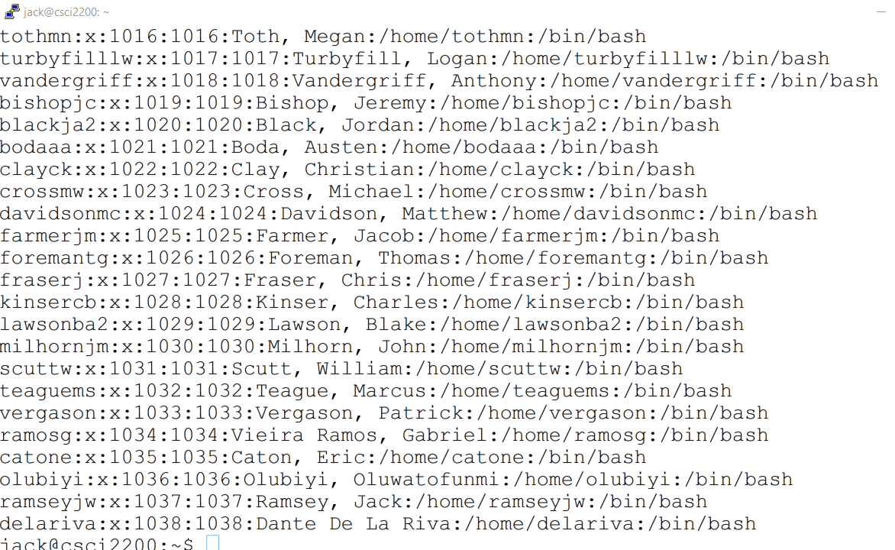
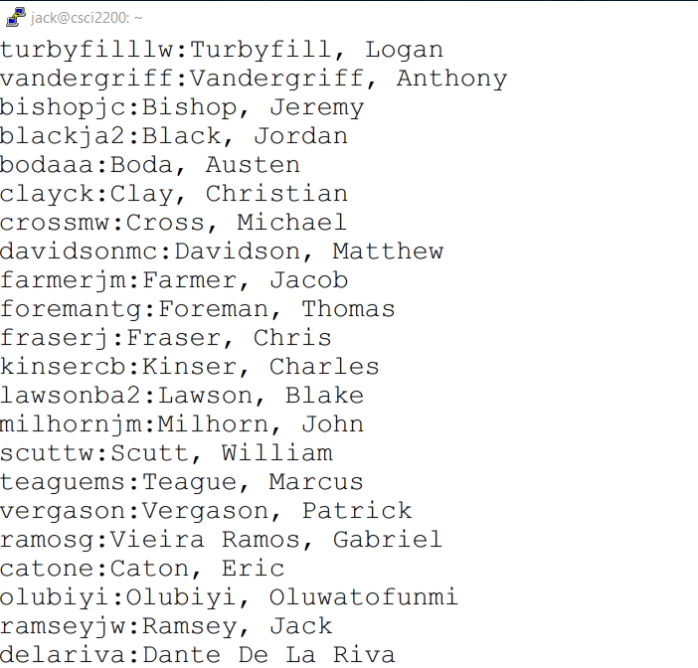
cut – get vertical slices (columns) from source

Slide 22
grep - extract content by pattern match
About grep
  short for global regular expression print
    pun on grope?
    searches texts for matches with regular expressions
    generates output, depending on matches, options
Here: a first pass through grep
  show simple functionality
  full discussion in regular expressions

Slide 23
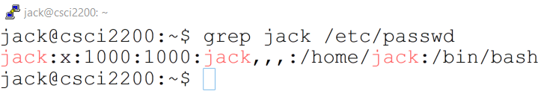
grep
grep pattern file₁ file₂ …
return all lines in file₁ file₂ … with content that matches pattern
pattern - a regular expression – it supports the following syntax
letters and numbers – in isolation, represent themselves
\n – newline
\r – return
\t – horizontal tab
\v – vertical tab
\f – form feed
\[ \] \\ \. \' \^ \$ – denote [ ] \ . ' ^ $

Slide 24
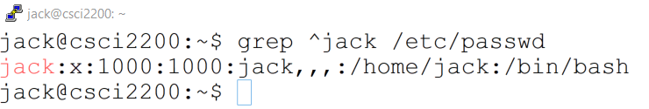
grep – more pattern syntax
. - matches any one character
^ - as pattern's 1st char, anchors pattern at start of line
  otherwise, simply denotes itself
  to match ^ at the start of a pattern, write \^
$ - as pattern's last char, anchors pattern at end of line
  otherwise, simply denotes itself
  to match $ at the end of a pattern, write \$

Slide 25
grep – more pattern syntax

Slide 26
Sample File – geisel.txt
One fish
Two fish
Red fish
Blue fish.
Black fish
Blue fish
Old fish
New fish.
This one has a little star.
This one has a little car.
Say! What a lot
Of fish there are.
1
2
3
4
5
6
7
8
9
10
11
12
13
14

Slide 27
What Lines are Returned by…
grep fish geisel.txt ?
grep a geisel.txt ?
grep ' a ' geisel.txt ?
grep '!' geisel.txt ?
grep '' geisel.txt ? # two single quotes
grep '^$' geisel.txt ?
grep '.' geisel.txt ?

Slide 28
What Lines are Returned by…
grep '^.$' geisel.txt ?
grep '^……..$' geisel.txt ?
grep 'fish$' geisel.txt ?
grep 'fish\$' geisel.txt ?
grep 'fish.' geisel.txt ?
grep 'fish\.' geisel.txt ?
grep 'fish..' geisel.txt ?

Slide 29
grep : additional options (selected)
Showing context:
-A n - show n lines of trailing context per match (A=after)
-B n - show n lines of leading context per match (B=before)
-C n - show n lines of context for each match

Slide 30
grep : repetition counts
More special syntax for grep patterns:
\{n\} - match n occurrences of the preceding character
\{m,n\} - match m to n occurrences of the preceding char
\{n,\} - match n or more occurrences of the preceding char
What lines are returned by
grep '.\{10\}' geisel.txt ?
grep '.\{10,\}' geisel.txt ?
grep '^.\{10\}$' geisel.txt ?
grep '.\{8,10\}' geisel.txt ?
grep '^.\{8,10\}$' geisel.txt ?

Slide 31
grep : -i, -w, -v options
What lines are returned by
grep o geisel.txt ?
grep -i o geisel.txt ?
grep '^o' geisel.txt ?
grep -i '^o' geisel.txt ?
grep a geisel.txt ?
grep -w a geisel.txt ?
grep -v fish geisel.txt ?
grep -v 'fish$' geisel.txt ?
grep -v 'fish\$' geisel.txt ?
grep -v 'fish.' geisel.txt ?
grep -v 'fish\.' geisel.txt ?
grep -v 'fish\..' geisel.txt ?
-i ignore case – treat upper and lower case as the same
-w select only those lines for which matches correspond to whole words
-v return all lines without content that matches pattern

Slide 32
grep : -o option
-o return just those content fragments from files that match pattern
uninteresting for patterns comprised solely of "ordinary" characters
much more interesting when match patterns contain
  "wild card" metacharacters like ●
  "variable number of occurrences" constructs
  "either-or" metacharacters (more later)
What content is returned by
grep -i -o '..o' geisel.txt ?
grep -i -o '.o.' geisel.txt ?
grep -i -o 'o..' geisel.txt ?
grep -i -o '.\{2\}o.\{2\}' geisel.txt ?

Slide 33
grep -l, -L
Return names of files from list of files with
  (-l) at least one line matching a user-specified regexp
  (-L) no lines that match a user-specified regexp
  Starting with
  echo one fish > 1.txt; echo two fish > 2.txt
  what lines are returned by
  grep -l fish 1.txt 2.txt ?
  grep -L fish 1.txt 2.txt ?
  grep -l one 1.txt 2.txt ?
  grep -L one 1.txt 2.txt ?

Slide 34
uniq - check for identical adjacent lines
uniq file # first line of each run
uniq -u file # lone line in runs of 1
uniq -d file # first line in runs of 2 or more
uniq -D file # all lines in runs of 2 or more
additional options (selected)
-w N – compare just the first N characters
-s N – skip the first N characters for the comparison

Slide 35
uniq - examples
For the five-line file file.txt at right, what would be returned by each of the following commands?
448
449
450
460
461
default – first of each run
-u - lone in runs of 1
-d - first in runs of >1
-D - all in runs of >1
-w n – stop after n chars
-s n – start after n chars
uniq file.txt
uniq -u file.txt
uniq -d file.txt
uniq -D file.txt

Slide 36
Summarizers
Goal: compute information about a stream's attributes
Three presented here:
  wc ("word count") – compute
    number of lines, words, and/or characters in a stream, and/or
    number of characters in a stream's longest line
  grep -c – return count of matching lines for given pattern
  uniq -c – like uniq, but prepends a count of identical lines to each line of output

Slide 37
wc ("word count")
wc -l file - output number of lines in file
wc -L file - output length of longest line in file
wc -w file - output number of words in file: i.e., whitespace-separated runs of characters
wc -m file - output number of characters in file
wc -c file - output number of bytes in file
As a rule, -m and -c will yield different totals for Unicode files and the same totals for standard 7/8-bit ASCII
When more than one option is specified, wc outputs newline count, word count, byte count, and max line length in that order, followed by
  the filename, if specified on the command line
  nothing otherwise

Slide 38
grep -c - count number of matches
grep -c pattern overrides all other grep options, returning a count of the number of matches between an input stream and a pattern.
Given the file geisel.txt (right), what output does each of the following commands return?
grep -c fish geisel.txt
grep -c -i -o '..o' geisel.txt
grep -n -i -o '.a.' geisel.txt
One fish
Two fish
Red fish
Blue fish.
Black fish
Blue fish
Old fish
New fish.
This one has a little star.
This one has a little car.
Say! What a lot
Of fish there are.

Slide 39
grep -c - count number of matches
grep -c pattern overrides all other grep options, returning a count of the number of matches between an input stream and a pattern.
Given the file geisel.txt (below right), what output does each of the following commands return?
grep -c fish geisel.txt
9 (matches lines 1-4,6-9,14)
grep -c -i -o '..o' geisel.txt
4 (matches lines 2, 11-13)
grep -n -i -o '.a.' geisel.txt
11 (matches lines 6, 11-13 (3x ea.), 14)
One fish
Two fish
Red fish
Blue fish.
Black fish
Blue fish
Old fish
New fish.
This one has a little star.
This one has a little car.
Say! What a lot
Of fish there are.

Slide 40
uniq -c - prepend count of lines
phil
armstrongpz
phil
phil
phil
phil
phil
phil
bishopbj
phil
muncya
muncya
muncya
barrettm
phil
phil
phil
phil
muncya
phil
Given this fragment from the first column from last.txt (right), what output does uniq -c return?
How would this output change if the fragment was sorted in ascending order?
Which of the initial questions might this output speak to?

Slide 41
uniq -c - prepend count of lines
phil
armstrongpz
phil
phil
phil
phil
phil
phil
bishopbj
phil
muncya
muncya
muncya
barrettm
phil
phil
phil
phil
muncya
phil
Given this fragment from the first column from last.txt (right), what output does uniq -c return?
How would this output change if the fragment was sorted in ascending order?
Which of the initial questions might data like this address?
  number of logins per user over the span of the login log file
before sorting,
uniq -c returns
1 phil
1 armstrongpz
6 phil
1 bishopbj
1 phil
3 muncya
1 barrettm
4 phil
1 muncya
1 phil
after sorting,
uniq -c returns
1 armstrongpz
1 barrettm
1 bishopbj
4 muncya
13 phil

Slide 42
Mutators
Goal: alter order and/or content of source stream
Five mutators presented here:
  Three flavors of transliterate (tr):
    tr – letter-by-letter substitution
    tr -d – deletion of specified characters
    tr -s – condensation ("squeezing") of multi-character sequences to single characters
  Substitute for regular expression (sed -e s/../../)
  Sort lines in stream (sort)

Slide 43
tr – (basic) transliteration
tr charlist₁ charlist₂ <file
write file to stdout, changing
all occurrences of charlist₁[k]
to charlist₂ [ min( k, len(charlist₂) ) ]
Notes:
All input to tr must be redirected from stdin.
All transliteration is character-for-character
  multi-char transliteration is not supported.

Slide 44
tr – escape sequences, shorthands
The charlist syntax supports these notations:
\NNN – octal char with the value nnn
\\ – backslash
\n – newline
\r – return
\t – tab
c1-c2 – all chars from c1 to c2, in ascending order
[:alnum:] – all letters and digits
[:blank:] – all horizontal whitespace
[:cntrl:] – all control chars
[:digit:] – all digits
[:graph:] – all printable chars, not including space
[:lower:] – all lower case letters
[:print:] – all printable chars, including space
[:punct:] – all punctuation chars
[:space:] – all whitespace
[:upper:] – all upper case letters

Slide 45
tr -d – (deleting) transliteration
tr -d charlist <file
write file to stdout, removing all occurrences of characters in charlist
Notes:
All input to tr -d must be redirected from stdin.

Slide 46
tr -s – (squeezing) transliteration
tr -s charlist <file
write file to stdout, changing
all repeating occurrences of characters in charlist
to individual characters
Notes:
All input to tr -s must be redirected from stdin.

Slide 47
sed s command – basic form
sed s/pattern/replacement/[g] [file]
sed -e s/pattern/replacement/[g] [file]
on lines with strings that match pattern,
substitute replacement for
  all occurrences of pattern, if the final g is present
  just the first occurrence of pattern on that line,
  if g is missing
writing the resulting output to stdout
if file is missing, input taken from stdin

Slide 48
sed s command – sed patterns
sed patterns, which correspond to regular expressions, are
interpreted according to special conventions that include these:
\ . ^ $ [ ] must be preceded by a backslash (\) when used as literals
standard sed conventions for escaped characters include
  \\ denotes \ ￚ \n denotes newline ￚ \t denotes horizontal tab
an initial ^ in a pattern matches the start of a line
a final $ in a pattern matches the end of a line
. matches any one character
\{n\} matches n occurrences of the preceding subpattern
\{m,n\} matches m to n occurrences of the preceding subpattern

Slide 49
sed s - examples
Consider the 14-line file, geisel.txt (lower right).
Line numbers are for convenience – they aren't in the file.
Which lines do these commands change? How do they change them?
sed 's/fish/cat/' geisel.txt
sed 's/fish$/cat/' geisel.txt
sed 's/a/@/' geisel.txt
sed 's/a/@/g' geisel.txt
sed 's/\n\r$/\n/' geisel.txt
1 | One fish
2 | Two fish
3 | Red fish
4 | Blue fish.
5
6 | Black fish
7 | Blue fish
8 | Old fish
9 | New fish.
10
11 | This one has a little star.
12 | This one has a little car.
13 | Say! What a lot
14 | Of fish there are.

Slide 50
sed s - examples
Consider the 14-line file, geisel.txt (right).
Line numbers are for convenience – they aren't in the file.
Which lines do these commands change? How do they change them?
sed 's/fish/cat/' geisel.txt
1-4,6-9,14 - fish → cat
sed 's/fish$/cat/' geisel.txt
1-3,6-8 - fish → cat
sed 's/a/@/' geisel.txt
6,11-14 - first a on each line → @
sed 's/a/@/g' geisel.txt
6,11-14 - all a's on each line → @
sed 's/\n\r$/\n/' geisel.txt
depends on input's format;
convert DOS EOLs to Unix EOLs
1 | One fish
2 | Two fish
3 | Red fish
4 | Blue fish.
5
6 | Black fish
7 | Blue fish
8 | Old fish
9 | New fish.
10
11 | This one has a little star.
12 | This one has a little car.
13 | Say! What a lot
14 | Of fish there are.

Slide 51
sed s - examples
Consider the 14-line file, geisel.txt (right).
Line numbers are for convenience – they aren't in the file.
Which lines do these commands change? How do they change them?
sed 's/./!!/' geisel.txt
sed 's/^/!!/' geisel.txt
sed 's/\./!!/' geisel.txt
sed 's/! /!\n/' geisel.txt
1 | One fish
2 | Two fish
3 | Red fish
4 | Blue fish.
5
6 | Black fish
7 | Blue fish
8 | Old fish
9 | New fish.
10
11 | This one has a little star.
12 | This one has a little car.
13 | Say! What a lot
14 | Of fish there are.

Slide 52
sed s - examples
Consider the 14-line file, geisel.txt (right).
Line numbers are for convenience – they aren't in the file.
Which lines do these commands change? How do they change them?
sed 's/./!!/' geisel.txt
1-4,6-9,11-14 –
first char on each line → !!
sed 's/^/!!/' geisel.txt
all lines - !! inserted at front
sed 's/\./!!/' geisel.txt
4,9,11,12,14 - final . → !!
sed 's/! /!\n/' geisel.txt
splits line 13 at the !
1 | One fish
2 | Two fish
3 | Red fish
4 | Blue fish.
5
6 | Black fish
7 | Blue fish
8 | Old fish
9 | New fish.
10
11 | This one has a little star.
12 | This one has a little car.
13 | Say! What a lot
14 | Of fish there are.

Slide 53
sed s – address ranges
[address_range] s/pattern/replacement/[g]
an initial address_range qualifier, when specified, limits pattern replacement to just the lines that address_range denotes, as follows:
k – just line k
k,m – lines k through m
$ – just the last line
k~n – every nth line starting with line k

Slide 54
sed s - examples
Consider the 14-line file, geisel.txt (right).
Line numbers are for convenience – they aren't in the file.
Which lines do these commands change? How do they change them?
sed '1 s/fish/fs/' geisel.txt
1 fish → fs
sed '1,4 s/fish/fs/' geisel.txt
1-4 fish → fs
sed '$ s/\./.../' geisel.txt
14. final . → …
sed '/star/ s/has/<has>/' geisel.txt
11 brackets <has>
sed '/fish$/ s/$/./' geisel.txt
1-3,6-8. adds . after fish
1 | One fish
2 | Two fish
3 | Red fish
4 | Blue fish.
5
6 | Black fish
7 | Blue fish
8 | Old fish
9 | New fish.
10
11 | This one has a little star.
12 | This one has a little car.
13 | Say! What a lot
14 | Of fish there are.

Slide 55
sort
sort options filename
sorts a file, as qualified by the following options:
  -u unique; eliminate duplicate lines
  -tchar use char as field separator (default whitespace)
  -k specify sort (keys) (default: entire lines)
  -k p1,p2 use as a sort key fields p1 .. p2
  -k p1 use as a sort key field p1 through end of line
sort keys may be specified in one of two forms:
  fno field number fno (1-index)
  fno.col column number col within field number fno (1-index)
if multiple keys are specified, their order determines primacy: e.g.,
  the 2nd (secondary) key breaks ties in 1st key (primary) field values
  the 3rd (tertiary) key breaks ties in the 1st and 2nd field value pairs

Slide 56
sort – semantic qualifiers
The following options qualify the interpretation of a command's sort keys:
  -b ignore leading blanks
  -f fold (i.e., ignore) case
  -n sort based on numeric values
  -g sort based on general numeric values

Slide 57
sort – semantic qualifiers
The following options qualify the interpretation of a command's sort keys:
  -h sort based on human-readable numerics (e.g., 2G, 1K)
  -r reverse sort (descending rather than ascending)
  -M sort using month order (i.e. Jan comes before Feb)
  These options may be specified
in a command's options list—in which case, they apply by default to all keys they precede
as individual letters, appended to individual keys—in which case, they apply to those keys specifically

Slide 58
sort keys: fine points
  Recommendation: qualify all numeric fields using -n or the n suffix
  best practice when fields have a uniform number of digits
  essential for fields with variable length digit strings
-k m vs. -k m,m
  -k m sorts based on what's in field m to the end of the line
  -k m,m sorts based on just what's in field m
  as a rule, specify -k m,m rather than -k m
    limiting sort keys to the fields to which they pertain is particularly important for sorts with 2 or more keys

Slide 59
sort keys: fine points
-k m.i,m.j
  -k m.i,m.j sorts based on what's in characters i..j
  in field m
  use requires care, in that sort can produce unexpected results when instances of field m have fewer than j characters
-u option
  -u is a convenient shorthand for sort; uniq command sequence
    sort; uniq command sequence common for converting a list to a set
    -u also checks for uniqueness across all sort keys – functionality that sort ; uniq doesn’t readily provide

Slide 60
Pipes: Motivating Example
Goal: find users and number of logins
Plan of attack:
  Use last -w to display the list of user logins
  Use cut to get the first column
  sort the list
  Use uniq -c to get the number
  last -w | cut -f 1 -d ' ' | sort | uniq -c

Slide 61
Pipes vs. Redirection
Similarities
  Pipes and redirection direct data to and from processes
Differences
  Pipes transmit data between processes: i.e.,
    from the stdout and/or stderr of one process
    to the stdin of another
  Redirection directs data between a process and a file: i.e.,
    from a file to a process's stdin
    from a process's stdout and/or stderr to a file

Slide 62
Pipes and Jobs: Terminology
The set of processes that participate in a common pipeline are known as a job
Unix provides commands for managing users' jobs as well as their processes
  These will be featured in an upcoming lecture

Slide 63
Pipes: Assessment
Importance: essential
Basic to Unix scripting
Also basic to newer, interpreted languages like Ruby
Flow-based paradigm standard for functional programming

Slide 64
Pipes: Assessment
Disadvantages:
Can lessen readability for inexperienced users and complicate debugging
Advantages:
Make logic more concise - hence, easier to read for experienced users
Can eliminate temp files: hence, the need to
  avoid the accidental overwriting of user files with the same names
  clean up after normal and error termination
On multicore architectures, support ready parallelization of logic

Slide 65


